Slide 1
PROS O&D FORECASTER
New Joiner Training – Day 1
June 2014

Slide 2
Objective
Provide an understanding of the role of the Forecaster component in the overall O&D Process

Slide 3
Agenda
O&D System Overview
Forecaster Overview
Important O&D Forecasting Terminologies
Introduction to O&D Forecaster Functionality
Bayesian Methodology
Inputs to O&D Forecaster
Booking and Cancellation Transaction
Schedule
Departure Time Window
DCPs (Data Collection Point)
Significant O&D/ POS
Discussion/Review

Slide 4
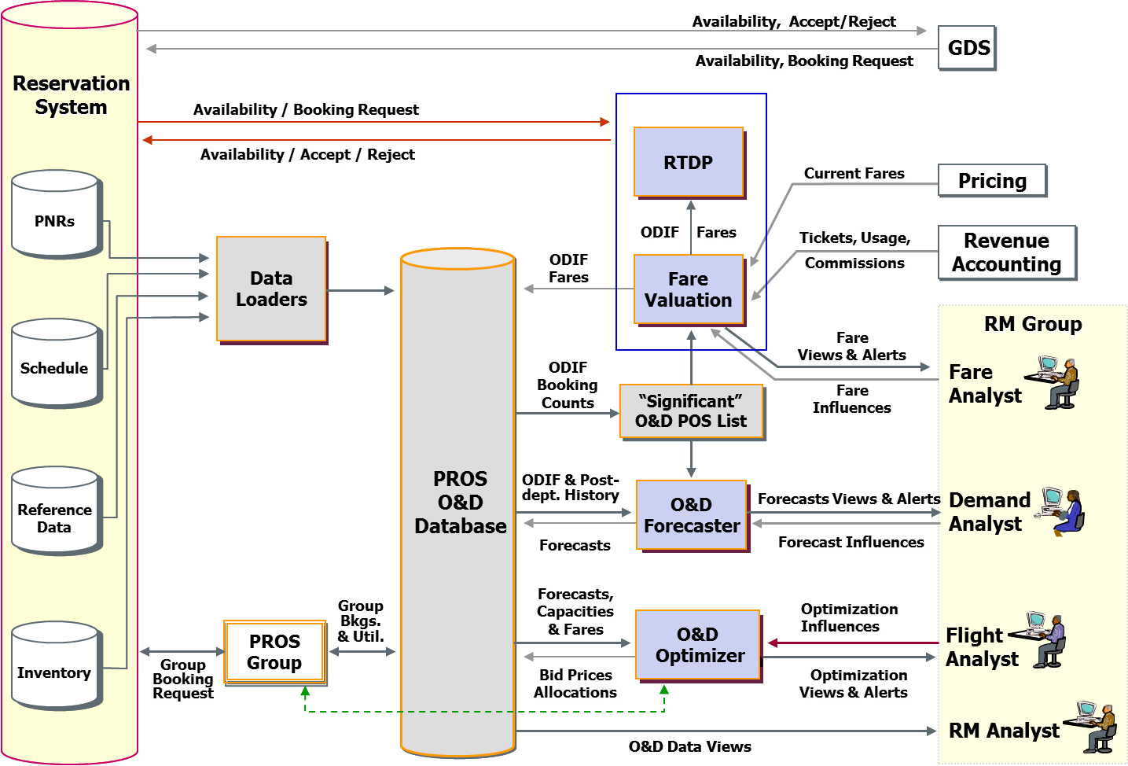
Forecaster in O&D Workflow

Slide 5
Important Terms
Online O&Ds
Part of, or entire, itinerary for which QR controls inventory decisions
Trip O&Ds
Entire itinerary, regardless of availability control
Example:
(QR) DOH - LHR connects to CO LGW – IAH
Online O&D: DOH – LHR
Trip O&D: DOH – IAH

Slide 6
Important Terms (cont’d)
ODI = Origin, Destination, Itinerary
Origin = Beginning of an online O&D
Destination = End of an online O&D
Itinerary = Sequence of unique flight legs
Example:
BOM – DOH – LHR QR 201 (5:45 –6:55) )/QR 011 (7:40-12:25)
BOM – DOH – LHR QR 201 (5:45 – 6:55)/QR 001 (12:45-17:30)

Slide 7
Important Terms (cont’d)
ODP = Origin, Destination, Path
Origin = Beginning of an online O&D
Destination = End of an online O&D
Path = Sequence of traversed airport codes
Example:
DOH – LHR
BOM – DOH – LHR

Slide 8
Forecaster Overview
The purpose is to forecast passenger demand at the ODIF (Origin & Destination Itinerary Fare class) level, based on the open-for-sale schedule ( Unconstraining logic ) and historical data
Separate booking & cancellation forecasts at ODIF level
Forecast show-up rates at the leg class level
Separate forecasts for individuals and groups
Aggregation/disaggregation of forecasts

Slide 9
PROS O&D Forecaster – User Influences
User Adjustments
Multiplicative adjustments
Additive adjustments
Sponsorship
Demand Mapping
Holidays & Special Events
Overrides

Slide 10
Forecaster Dimensions
Booking and Cancellation Models
Online Origin
Online Destination
Trip Origin
Trip Destination
Path
POS
Day of Week
Departure Time Window
Travel Time
Passenger Type
Fare Class
Seasonality Class blocks

Slide 11
PROS O&D Forecaster
Demand Forecasting with Bayesian Methodology

Slide 12
Demand Forecasting Bayesian Methodology
“The essence of the Bayesian approach is to provide a mathematical rule explaining how you should change your existing beliefs in the light of new evidence. In other words, it allows scientists to combine new data with their existing knowledge or expertise.”
From The Economist print edition, September 30, 2000

Slide 13
Demand Forecasting Example of Bayesian Framework
Suppose a child observes his first rain and wonders if it will rain tomorrow
Before the child observes the events of the next day he is told of the two possibilities:
Rain
Not rain
The child gives these two possibilities an equal probability

Slide 14

Before Observing: A Guess
A child puts one black and one white marble into a bag to represent the events
A white marble represents the event that it will rain (black = not rain)
P(Rain) = P(WhiteMarble) = 1/2

Slide 15
The Next Day
It rains
The child places another white marble into the bag

Slide 16
Probability of Rain
The probability that the child will pick a white marble
has now increased from 0.5 to 0.67

Slide 17
On Day Three
It rains:
The child places another white marble into the bag

Slide 18
Probability of Rain
The probability that the child will pick a white marble has now increased from 0.67 to 0.75

Slide 19
After Many Rainy Days
The initial guess of a 0.5 probability that it will rain tomorrow moves closer to 1
It’s a near certainty that it will rain!!!

Slide 20
Demand Forecasting - Bayesian Methodology
Bayesian Methodology Advantages
Intuitive process ~ adapts as it goes along
Data does not need to be stored
Forecast distribution that incorporates both randomness and uncertainty

Slide 21
Demand Forecasting Bayesian Methodology
Bayesian Methodology Structure
Numerous forecasting entities
Examples: ODIF POS, Leg-Fare Class
Forecasting Guillotine
Data Collection Points (DCP)
Departure Dates

Slide 22
Demand Forecasting
Forecasting features
Forecasting at the DCP level
Identification of new trends
Hierarchy
Automatic seasonality
Holidays & Special Events
Unconstraining

Slide 23
Forecasting at the DCP level
Utilizes the latest DCP information to proactively identify new trends and variations from actual bookings
Does not limit history to departed flights
DP optimization requires accurate DCP-level forecasts in order to assess the optimal availability controls at each point prior to departure
PROS Bayesian Forecaster utilizes All information from the Guillotine

Slide 24
Guillotine
Data Collection Points
1 2 3 4 5 6 7 8 9 . . . . . . . . . 13 14 15 16 17
historical departure dates
observed
today
future departure dates

Slide 25
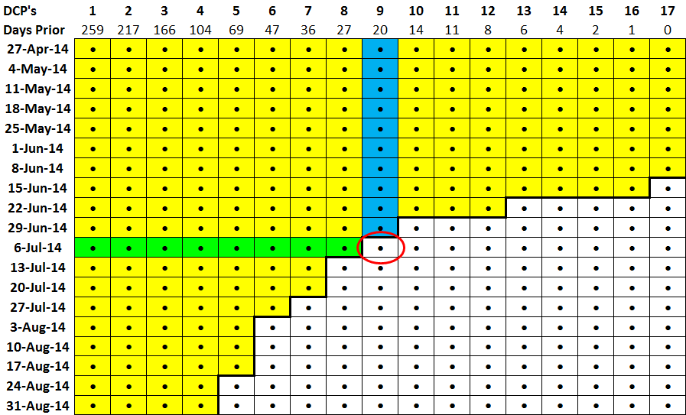
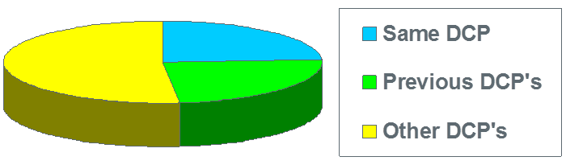
Guillotine structure

Slide 26
Automatic Seasonality
Seasonality is automatically calculated at the lowest forecast level and dynamically updated with each observation
This design enables the system to apply specific up-to-date seasonality to a large number of low-level entities
Users do not have to determine seasonality factors (or split history definitions) at a higher level, nor spend large amounts of time maintaining those values

Slide 27
PROS O&D Forecaster
Inputs to O&D Forecaster

Slide 28
Inputs to O&D Forecaster
Booking and
Cancellation
Transactions
Dept Time
Windows
Significant
O&Ds/POS
Schedule
DCPs
ODIF Forecasts

Slide 29
Calculating the ODIF
ODIF = Origin, Destination, Itinerary, Fare class
Class is obvious on a single class itinerary
Mixed class itineraries exists
Fare class on an O&D is determined based on the class of travel of the longest online leg in an O&D
Example: LHR – BOM, where passenger has B class on LHR – DOH and K class on DOH – BOM
The class of travel on LHR – DOH determines the class for the O&D (LHR – BOM)

Slide 30
Determining POS (Point of Sale)
POS as defined at the country or sub-country level
POS can be defined as traditional POS in the PNR or POS can be defined using the POC logic
POS information when using traditional POS is determined in RES and passed in the PNR input file for PROS O&D
QR uses POC based logic (described later)

Slide 31
Inputs to O&D Forecasting
Booking and
Cancellation
Transactions
Dept Time
Windows
Significant
O&Ds/POS
Schedule
DCPs
ODIF Forecasts

Slide 32
Schedule Data
Core data component
Provides flight arrival and departure time
Used as input to a connection builder function to generate the list of flight origin and destination itineraries (ODIs) open for sale
Used to determine flight legs comprising each online PNR segments
Necessary when mapping forecasts to applicable flight legs
Schedule is used to validate PNR segments to ensure the flights are in the schedule

Slide 33
Inputs to O&D Forecasting
Booking and
Cancellation
Transactions
Dept Time
Windows
Significant
O&Ds/POS
Schedule
DCPs
ODIF Forecasts

Slide 34
Departure Time Windows
They are used to alleviate or lessen the impact on the forecast modules due to flight number changes, thus perceived itinerary changes, etc.
The departure time window of the first online leg of an ODIF determines the path to which the ODIF will belong

Slide 35
Inputs to O&D Forecasting
Booking and
Cancellation
Transactions
Dept Time
Windows
Significant
O&Ds/POS
Schedule
DCPs
ODIF Forecasts

Slide 36
Data Collection Points (DCPs)
DCPs divide the booking curve into intervals during which the bookings arrival rate is assumed to be constant
Best defined as change points in the arrival process
Network level assignment
Analysis with QR’s data
How are DCPs used?
Observations are gathered and sent to the forecaster at the end of the DCP
Model update is done on a completed DCP
PROS O&D forecasts bookings and cancellation rate for each DCP interval

Slide 37
Inputs to O&D Forecasting
Booking and
Cancellation
Transactions
Dept Time
Windows
Significant
O&Ds/POS
Schedule
DCPs
ODIF Forecasts

Slide 38
Significant O&Ds / POS
Significant Trip O&Ds and POS are those which are deemed important to the network
Based on the number of non-directional net-bookings for a given period
Periodic update and thus reflects dynamic changes in market/network
Fare Valuation uses SigO&D PROD list (non-directional)
Demand Forecaster use SigO&D Directional list

Slide 39
Significant O&D and POS List
General characteristics of the SIG O&D List
Reflects O&Ds of all online non-stop legs
Most O&Ds have two (2) valid POS associated with them
The Origin and Destination POS
BOM LHR BOM LHR IN
BOM LHR BOM LHR GB

Slide 40
Defining POC
The Point of Commencement (POC) is defined as the beginning airport of the passenger’s journey
The POC will be treated as a new property of the PNR
It will be computed by the O&D system from the first loading of the PNR to O&D system.
The POC will remain constant at the passenger’s original point of commencement
Notes:
For PNR POC, it is always the first airport of the passenger’s journey whether this is an online airport or an offline airport.

Slide 41
Illustration
PNR A
PNR A
Seg1
Seg2
.
.
Seg4
Seg1
Seg5
Seg2
.
Seg4
PNR POC = Orig Country of Seg1
PNR POC = Orig Country of Seg1
1st Loading of PNR A
Revision on PNR A
Example:
PNR A:
1 LHR-DOH 1Sep
2 DOH-BKK 1Sep
3 BKK-DOH 10Sep
4 DOH-LHR 10Sep
PNR A:
1 CDG-DOH 1Sep
2 DOH-BKK 1Sep
3 BKK-DOH 10Sep
4 DOH-CDG 10Sep
PNR POC = GB
PNR POC = GB

Slide 42
How to Assign POC
For each O&D in the PNR:
. If the O&D and POS are in the SigO&D table and this is a third country POS
. . POS for the O&D = PNR POS
. else if the O&D is moving away from the POC
. . Direction = Outbound
. . POS for this O&D = country code of O&D online origin
. else
. . Direction = Inbound
. . POS for this O&D = country code of O&D online destination
See the samples in next slides.
Notes:
1. If ORG is closer to PNR POC = “moving away”
If DSTN is closer to PNR POC = “towards”
2. In determining Trnx POC, always use the “Online O&D” not Trip O&D.

Slide 43
Example 1:
PNR AAAAAA POS=QA:
1 LHR-DOH 1Sep
2 DOH-BKK 1Sep
3 BKK-DOH 10Sep
4 DOH-LHR 10Sep
Is it SIG OD/POS Third country?
Yes
POS=QA
LHR-BKK
BKK-LHR
PNR POC = LHR (GB)
No
POC logic:
LHR-DOH DOH-BKK:
Direction is moving away from POC GB → outbound → take onlorgn → POS=GB
BKK-DOH DOH-LHR:
Direction is moving closer to POC GB → inbound → take onldstn → POS=GB

Slide 44
Example 2:
PNR AAAAAA POS=CA:
1 YYZ-LHR 2Sep
2 LHR-DOH 2Sep
3 DOH-CMB 3Sep
4 CMB-DOH 10Sep
5 DOH-LHR 10Sep
6 LHR-YYZ 11Sep
Is it SIG OD/POS Third country?
Yes
POS=CA
YYZ-CMB
CMB-YYZ
PNR POC = YYZ (CA)
No
POC logic:
YYZ-LHR-DOH-CMB:
Direction is moving away from POC=CA → outbound → take onlorgn → POS=GB
CMB-DOH-LHR-YYZ:
Direction is moving towards POC=CA → inbound → take onldstn → POS=GB

Slide 45
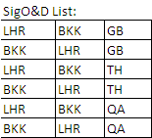
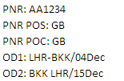

Example 3:

Slide 46
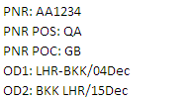

Example 4:

Slide 47
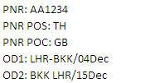
Example 5:

Slide 48
Inputs to O&D Forecasting
Booking and
Cancellation
Transactions
Dept Time
Windows
Significant
O&Ds/POS
Schedule
DCPs
ODIF Forecasts

Slide 49
Questions?

Slide 50
Thank you!

